Slide 1
Additive Increase Multiplicative Decrease (AIMD)

Slide 2
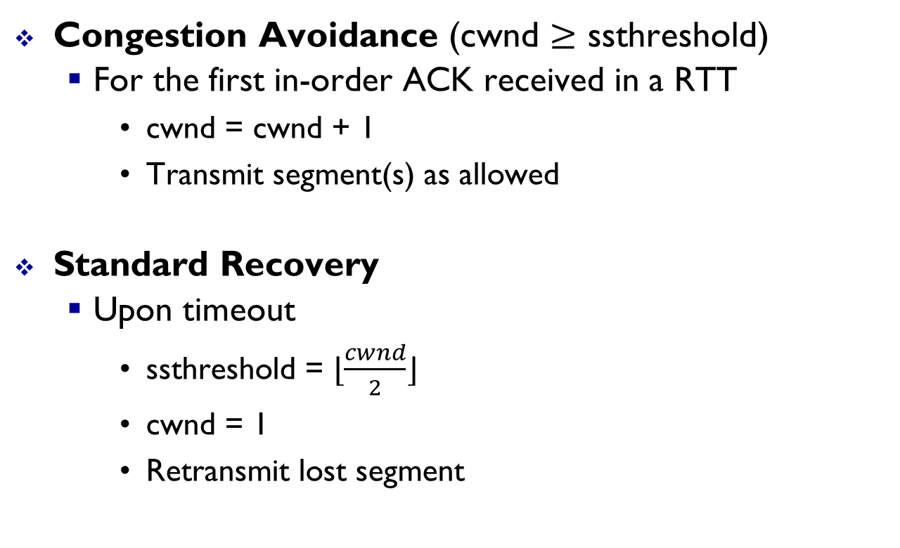


TCP and AIMD
Congestion Avoidance (cwnd $≥$ ssthreshold)
For the first in-order ACK received in a RTT
cwnd = cwnd + 1
Transmit segment(s) as allowed
Standard Recovery
Upon timeout
ssthreshold = $⌊\frac{cwnd}{2}⌋$
cwnd = 1
Retransmit lost segment
In general, cwnd = cwnd + $a$
In general, cwnd = cwnd $×b$, for $b∈[0, 1]$
cwnd = cwnd * (1/cwnd)

Slide 3


Additive Increase Multiplicative Decrease (AIMD)
Alicia
$$X_{goal}$$
Bob
Alice
Mark
Goal: Share available resources in a fair and efficient manner.
Splitting resources: An example on splitting $100
Person A’s share | Person B’s share | Outcome
$30 | $40 | Neither fair nor efficient
$30 | $30 | Fair but not efficient
$10 | $90 | Efficient but not fair
$50 | $50 | Efficient and fair

Slide 4


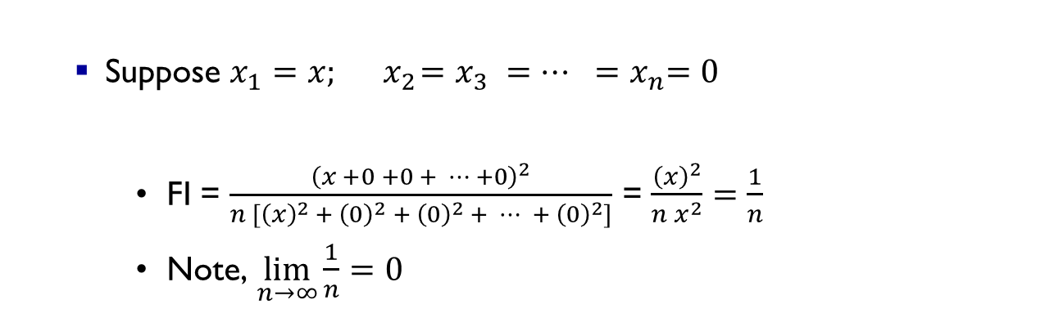

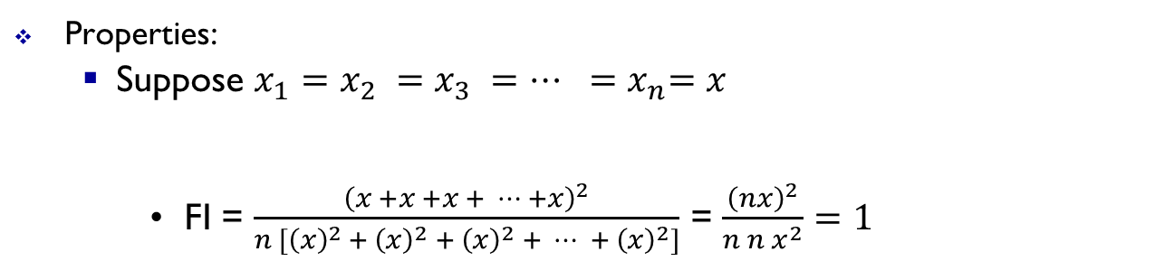

Fairness Index (FI)
For $n$ users in a system, with user $i$ having a share of $x_{i}$ amount of resources, the fairness index is given by:
Fairness Index (FI) = $\frac{{\left(x_{1} +{ x}_{2} +{ x}_{3} + ⋯ +{ x}_{n}\right)}^{2}}{n [{\left(x_{1}\right)}^{2 }+{ \left(x_{2}\right)}^{2} +{ \left(x_{3}\right)}^{2} + ⋯ + {\left(x_{n}\right)}^{2}]}$ = $\frac{(\sum_{i=1}^{n}{x_{i})^{2} }}{n \sum_{i=1}^{n}{{\left(x_{i}\right)}^{2 }}}$
Properties:
Suppose $x_{1}=x_{2} =x_{3} =⋯ {=x}_{n}=x$
FI = $\frac{{\left(x +x +x + ⋯ +x\right)}^{2}}{n [{\left(x\right)}^{2 }+{ \left(x\right)}^{2} +{ \left(x\right)}^{2} + ⋯ + {\left(x\right)}^{2}]}$ = $\frac{{\left(nx\right)}^{2}}{n n x^{2}}=1$
$$n$$
Suppose $x_{1}=x;{ x}_{2}=x_{3} =⋯ {=x}_{n}=0$
FI = $\frac{{\left(x +0 +0 + ⋯ +0\right)}^{2}}{n [{\left(x\right)}^{2 }+{ \left(0\right)}^{2} +{ \left(0\right)}^{2} + ⋯ + {\left(0\right)}^{2}]}$ = $\frac{{\left(x\right)}^{2}}{n x^{2}}=$ $\frac{1}{n}$
Note, $\lim_{n→∞}{\frac{1}{n}}=0$
$$n$$
Thus, $0≤FI≤1$

Slide 5





Fairness Index (FI)
For $n$ users in a system, with user $i$ having a share of $x_{i}$ amount of resources, the fairness index is given by:
Fairness Index (FI) = $\frac{{\left(x_{1} +{ x}_{2} +{ x}_{3} + ⋯ +{ x}_{n}\right)}^{2}}{n [{\left(x_{1}\right)}^{2 }+{ \left(x_{2}\right)}^{2} +{ \left(x_{3}\right)}^{2} + ⋯ + {\left(x_{n}\right)}^{2}]}$ = $\frac{(\sum_{i=1}^{n}{x_{i})^{2} }}{n \sum_{i=1}^{n}{{\left(x_{i}\right)}^{2 }}}$
Properties:
Suppose $k$-out-of-$n$ users have an equal share, with the remaining $n−k$ users receiving nothing. Then,
FI = $\frac{{\left(x + x + x + ⋯ + x + 0 + 0 + 0⋯ + 0\right)}^{2}}{n [{\left(x\right)}^{2 }+{ \left(x\right)}^{2} +{⋯+ \left(x\right)}^{2} + 0 + 0 + ⋯ + 0]}$ = $\frac{{\left(kx\right)}^{2}}{n k x^{2}}=$ $\frac{k}{n}$
$$k$$
$$n−k$$
$$k$$
$$n−k$$

Slide 6







A quick review of a line’s slope
$$(x_{2},y_{2})$$
Y-axis
$$y_{2}−y_{1}$$
$$(x_{1},y_{1})$$
$$θ$$
$$x_{2}−x_{1}$$
$Slope$ = $\tan{θ}= \frac{y_{2}−y_{1}}{x_{2}−x_{1}}$
$$(0,0)$$
X-axis

Slide 7













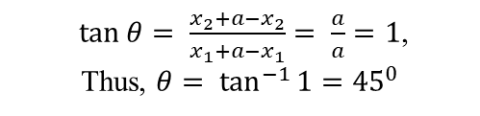

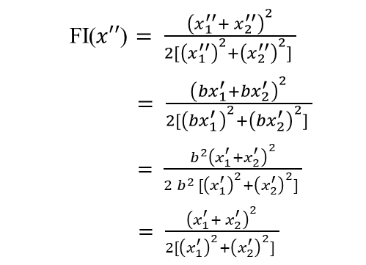

$\tan{θ}= \frac{x_{2}+a−x_{2}}{x_{1}+a−x_{1}}= \frac{a}{a}=1$,
Thus, $θ= \tan^{−1}{1}={45}^{0}$
AIMD
$\tan{θ′}= \frac{x_{2}^{′}−bx_{2}^{′}}{x_{1}^{′}−{bx}_{1}^{′} }= \frac{x_{2}^{′}(1−b)}{x_{1}^{′}(1−b)}=$ $\frac{x_{2}^{′}}{x_{1}^{′}}$
$$x′=(x_{1}^{′}=x_{1}+a,x_{2}^{′}=x_{2}+a)$$
$(0, X_{goal}$)
Overloaded
FI($x′$) $= \frac{{\left(x_{1}^{′}+{ x}_{2}^{′}\right)}^{2}}{2[{\left(x_{1}^{′}\right)}^{2}+{\left(x_{2}^{′}\right)}^{2}] }$
Underloaded
$$θ$$
$$(x_{1},x_{2})$$
FI($x′′$) $= \frac{{\left(x_{1}^{′′}+{ x}_{2}^{′′}\right)}^{2}}{2[{\left(x_{1}^{′′}\right)}^{2}+{\left(x_{2}^{′′}\right)}^{2}] }$
$= \frac{{\left({bx}_{1}^{′}+{bx}_{2}^{′}\right)}^{2}}{2[{\left({bx}_{1}^{′}\right)}^{2}+{\left({bx}_{2}^{′}\right)}^{2}] }$
$= \frac{{b^{2}\left(x_{1}^{′}+x_{2}^{′}\right)}^{2}}{2{ b}^{2 }[{\left(x_{1}^{′}\right)}^{2}+{\left(x_{2}^{′}\right)}^{2}] }$
$= \frac{{\left(x_{1}^{′}+{ x}_{2}^{′}\right)}^{2}}{2[{\left(x_{1}^{′}\right)}^{2}+{\left(x_{2}^{′}\right)}^{2}] }$
$$x=(x_{1},x_{2})$$
Fairness line
User 2’s allocation
$$θ′$$
$$x′′=(x_{1}^{′′}={bx}_{1}^{′},$$
$x_{2}^{′′}={bx}_{2}^{′})$
Optimal point = $(\frac{X_{goal}}{2},\frac{X_{goal}}{2})$
$$(x_{1},x_{2})$$
Efficiency line
$${45}^{0}$$
Thus, FI($x′$) = FI($x′′$)
$$(0,0)$$
$(X_{goal},0$)
User 1’s allocation
Moreover, FI($x′′$) > FI($x$)
For $(x_{1},x_{2})$ on efficiency line, $\frac{x_{2}−X_{goal}}{x_{1}−0}=\frac{0−X_{goal}}{X_{goal}−0}=−1$. Thus, $x_{1}+x_{2}=X_{goal}$
For $(x_{1},x_{2})$ on fairness line, $\frac{x_{2}−0}{x_{1}−0}=\tan{{45}^{0}}=1$. Thus, $x_{1}=x_{2}$

Slide 8
Thanks

